Slide 1

PHTV Bus Online Ticket

Slide 2




TEAM MEMBERS
Pham Huy Hoang
Tran Gia Toan
Le Pham Tran Phu
Bui Quoc Viet
Special thanks to instructor: Ms. Nguyen Ha Vy

Slide 3
INTRODUCTION
A is a pretty basic system implemented using ASP.NET, ReactJS, SQL Server.
PHTV Bus Ticket Booking System is designed to automate the online ticket purchasing through an easy online bus booking system. With PHTV bus ticket reservation system you can manage/book reservations, clients data and passengers lists through its Admin page and book tickets effortlessly through the Bus reservation Website.
Customer needs to register at the site to book tickets to the bus. After selecting the schedule, the user is presented a seating layout so that he can select seats of his choice.

Slide 4
TECHNOLOGY
SQL Server - A proprietary relational database management system developed by Microsoft.
ASP.NET - A server-side web-application framework designed for web development to produce dynamic web pages.
ReactJS - A JavaScript library for building user interfaces.
Redux - A predictable state container for JavaScript apps.
NodeJS - A JavaScript runtime built on Chrome's V8 JavaScript engine

Slide 5
FEATURES
Login/Logout to System with authentication, encrypt password
Search for schedule, filter the schedule by time, price and bus type
Select seat, purchase a Ticket, make online payments, apply discount voucher
Generates QR codes for confirmed tickets
Sends forget password email, confirm ticket order email
Ticket tracking
Cancel a Ticket and get refund
Register to be driver
Driver tracking their assigned bus and schedule
Overview Profit/Revenue by chart
Fully CRUD function in Admin page
…

Slide 6
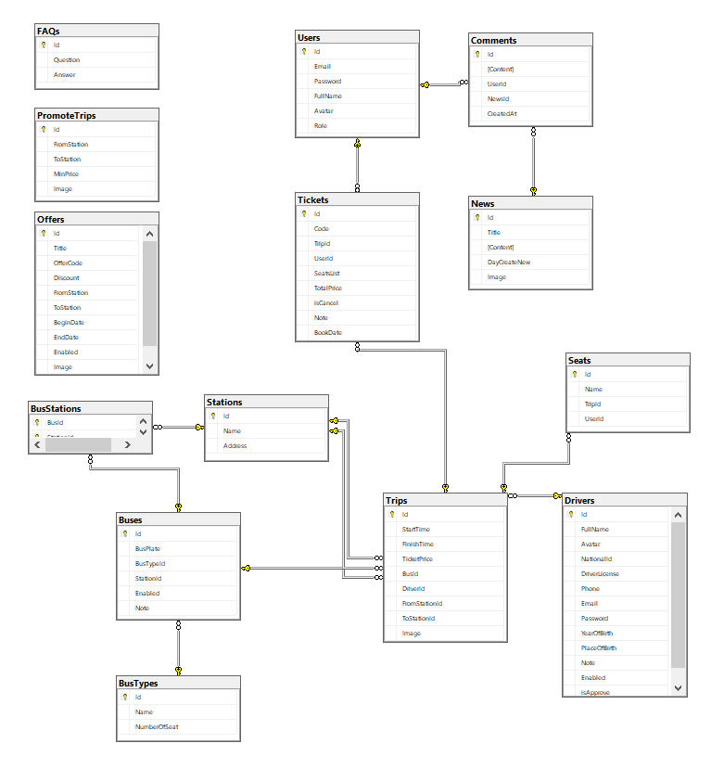
DATA STRUCTURE

Slide 7
TASK ASSIGNMENT
Pham Huy Hoang | Tran Gia Toan | Le Pham Tran Phu | Bui Quoc Viet
Full Bus and Bus Type CRUD. Full Schedule/Trip CRUD, able to assign Driver and Bus for each Schedule/Trip. Full Discount/Offer Code CRUD. Seat selecting for each type of bus. Order confirmation, can apply discount by age and code. Send ticket by email with QR Code. Cancel ticket and get refund. Review revenue/profit by chart. | Search for schedule/trip Sort and filter the schedule/trip by price, bus type, time… Full User CRUD, update profile and role. Full News CRUD, Full Comment CRUD belong to each news. | User Login/Logout, Register, Forget Passwod (send email). Driver Login/Logout, Register, Forget Passwod (send email). Authentication, encrypt password. Driver tracking schedule/trip under their assignment. Driver update profile. Full admin control Driver CRUD. | Full Frequency Asked Question CRUD. Full Popular routes features CRUD and automatic find lowest price of each route. Full Station CRUD. Check ticket status function at both client and admin site.

Slide 8
Thank you very much!

